Slide 1
Terraform

Slide 2
Main topics
What is Terraform.
Overview of Terraform.
Demo.

Slide 3
How to Provision an AWS Instance
Let's look at a few different ways you could provision a new AWS Instance. Before we start, we'll need to gather some basic information including:
Instance Name
Operating System (Image)
VM Size
Geographical Location (Region)
Security Groups

Slide 4
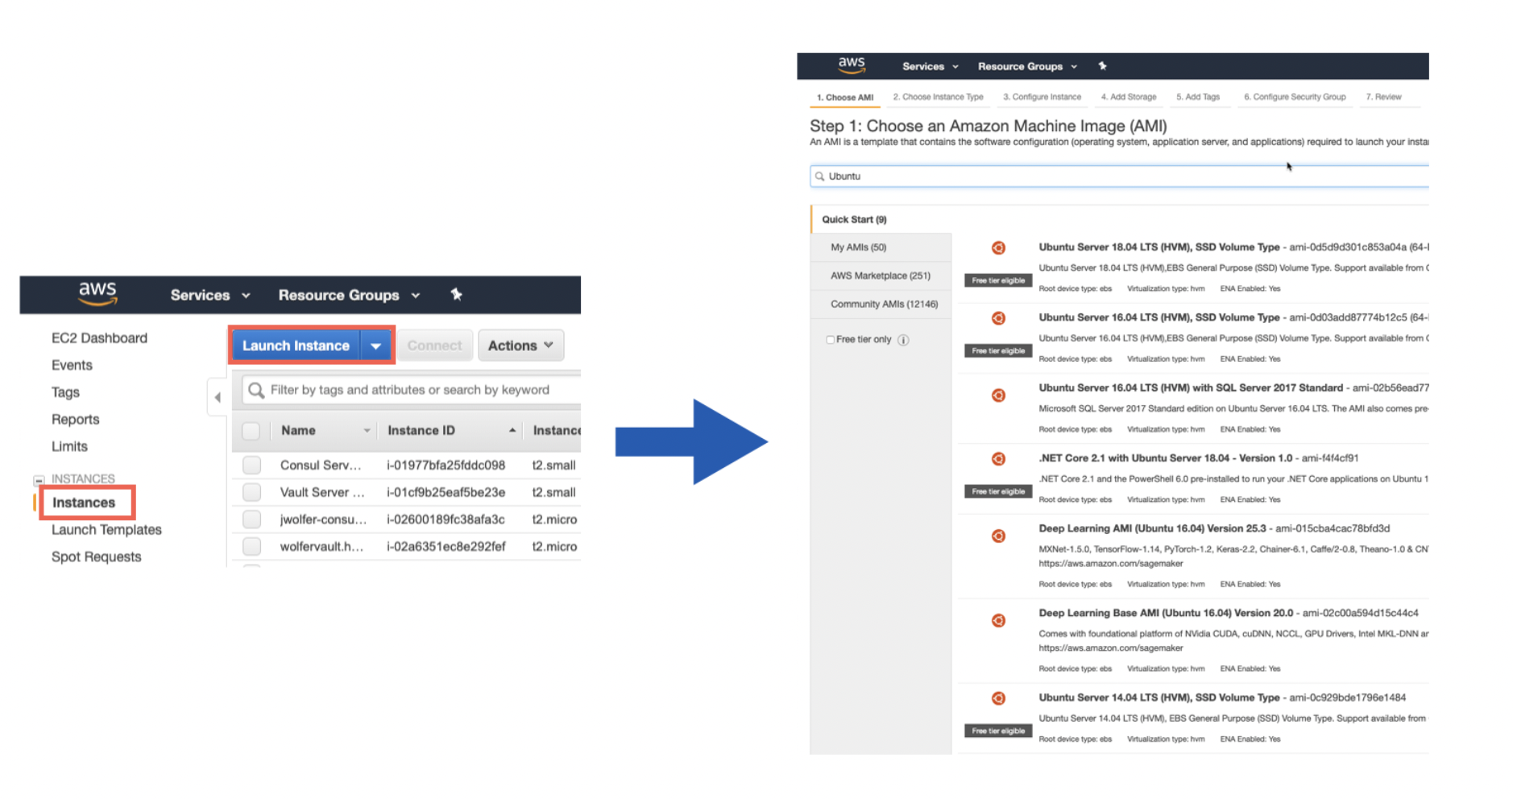
Method 1: AWS Console (GUI)

Slide 5
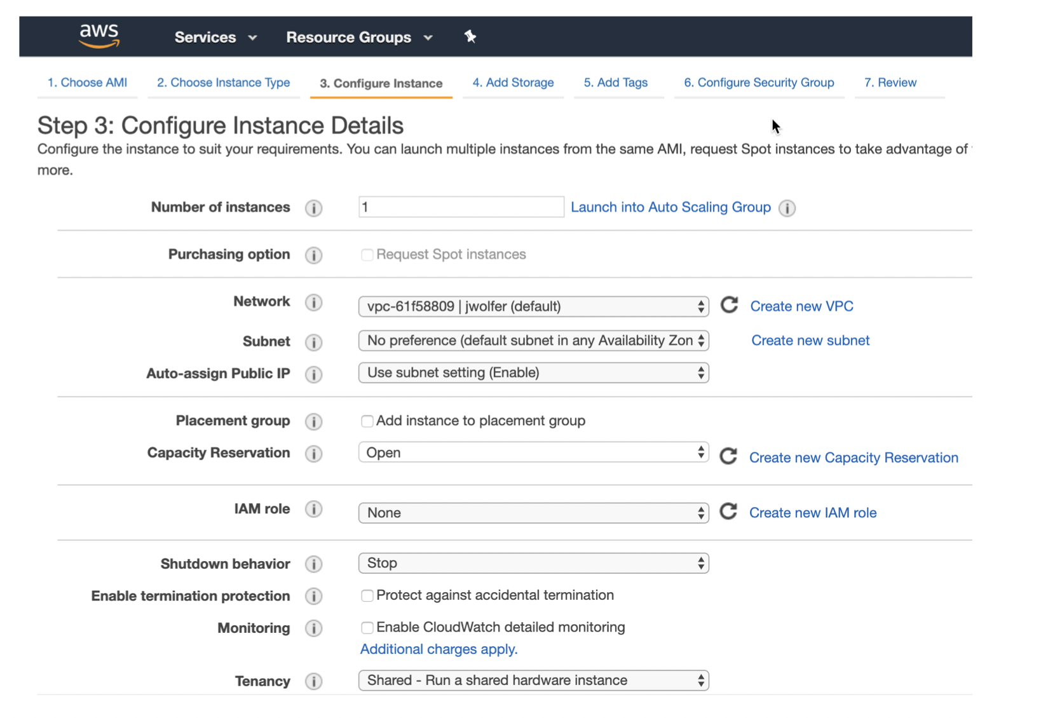
Method 1: AWS Console (GUI)

Slide 6
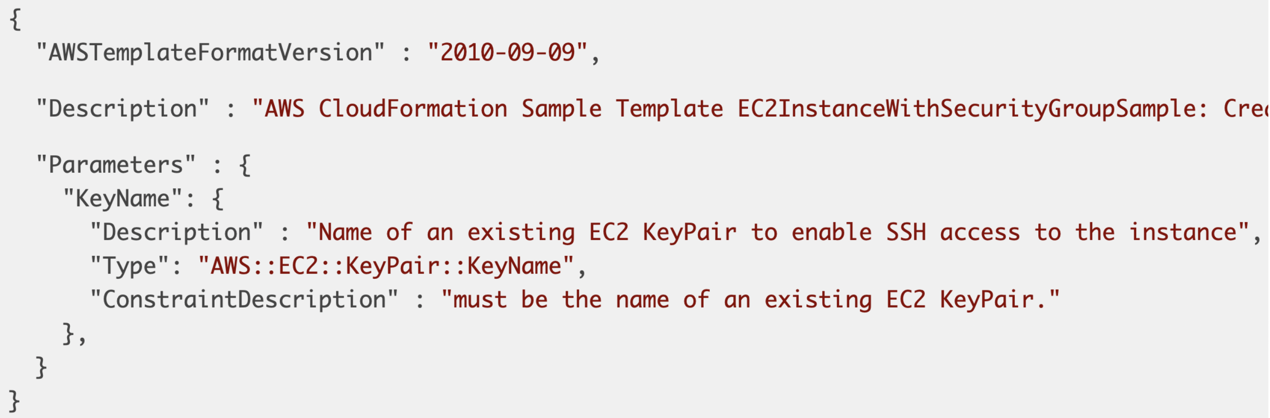
Method 2: CloudFormation Templates
CloudFormation Templates provide a consistent and reliable way to provision AWS resources. JSON is easy for computers to read. But can be challenging for humans to edit and troubleshoot.

Slide 7
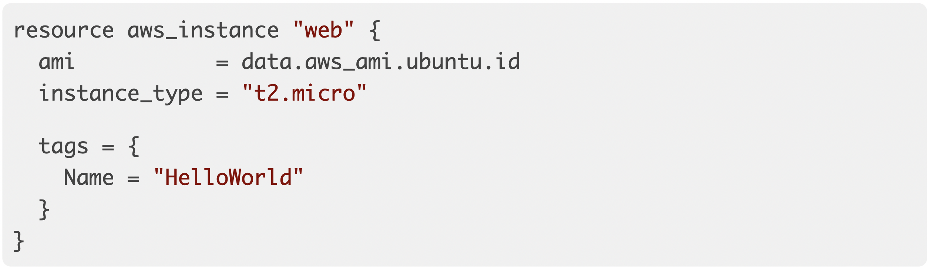
Method 3: Provision with Terraform

Slide 8
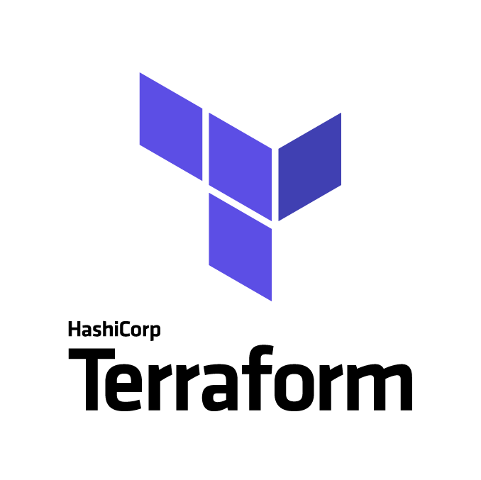
What’s terraform
Open source.
Terraform is a tool for provisioning infrastructure, from low-level components such as virtual machines, storage and networking, to higher-level components such as DNS entries.
Human and machine readable
Easy to learn
Test, share, re-use, automate
Works on all major cloud providers

Slide 9
What is Infrastructure as Code?
Infrastructure as Code (IaC) is the process of managing and provisioning cloud infrastructure with machine-readable definition files. Think of it as executable documentation.
Infrastructure as Code Allows Us To
Provide a codified workflow to create infrastructure
Change and update existing infrastructure
Integrate with application code workflows (Git, CI/CD tools)
Provide reusable modules for easy sharing and collaboration
Enable collaboration between different teams
…

Slide 10
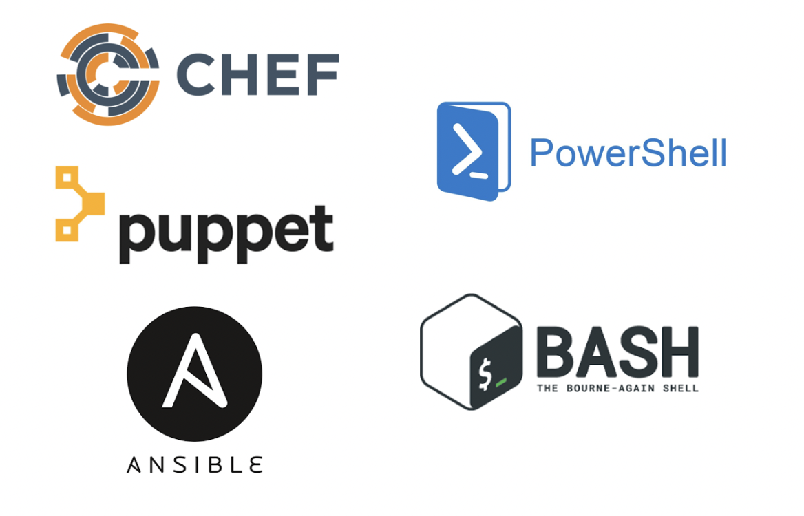
Other Infrastructure as Code Tools
These tools work well for configuring the operating system and application. They are not purpose-built for provisioning cloud infrastructure and platform services.

Slide 11
Terraform CLI
Terraform provides a list of subcommands as below:
Terraform init: is used to initialize a working directory containing Terraform configuration files. This is the first command that should be run after writing a new Terraform configuration or cloning an existing one from version control. It is safe to run this command multiple times.
Terraform plan: creates an execution plan, which lets you preview the changes that Terraform plans to make to your infrastructure. By default, when Terraform creates a plan it:
Reads the current state of any already-existing remote objects to make sure that the Terraform state is up-to-date.
Compares the current configuration to the prior state and noting any differences.
Proposes a set of change actions that should, if applied, make the remote objects match the configuration.

Slide 12
Terraform CLI
Terraform provides a list of subcommands as below:
Terraform apply: this command executes the actions proposed in a Terraform plan.
Terraform destroy: this command is a convenient way to destroy all remote objects managed by a particular Terraform configuration.

Slide 13
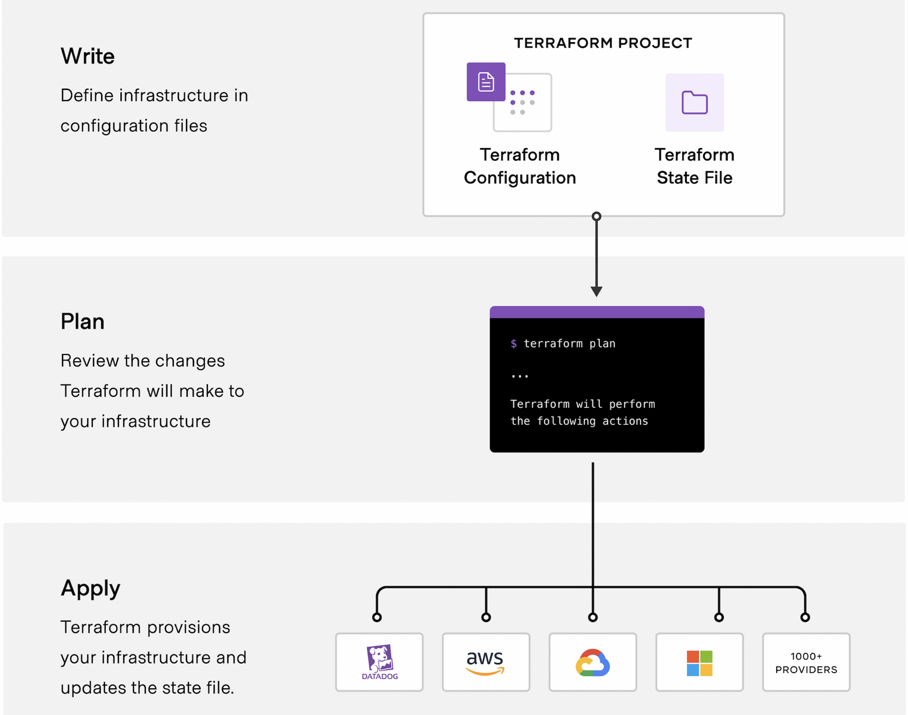
How terraform work?

Slide 14
Terraform workspace
A terraform workspace is simply a folder or directory that contains terraform code.
Terraform will read any file in your workspace that ends in a .tf extension.
Most terraform workspaces contain a minimum of three files:
main.tf - Most of your functional code will go here.
variables.tf - This file is for storing variables.
outputs.tf - Define what is shown at the end of a terraform run.

Slide 15
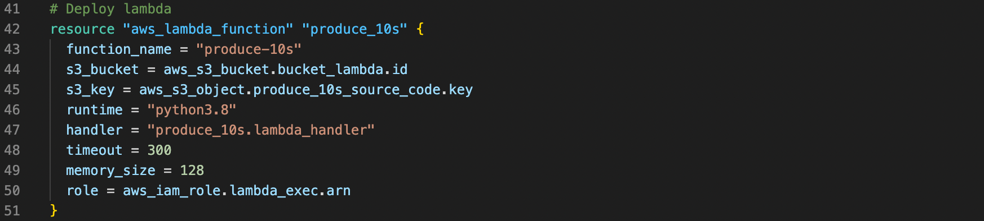
The main file
The first file is called main.tf. This is where you normally store your terraform code. With larger, more complex infrastructure you might break this up across several files.

Slide 16
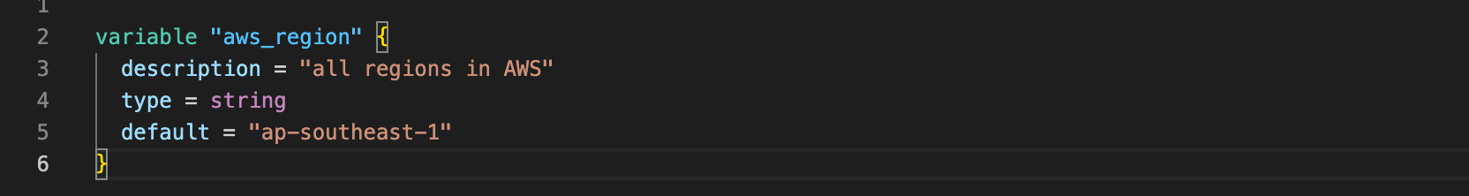
The Variables File
The second file is called variables.tf. This is where you define your variables and optionally set some defaults.

Slide 17
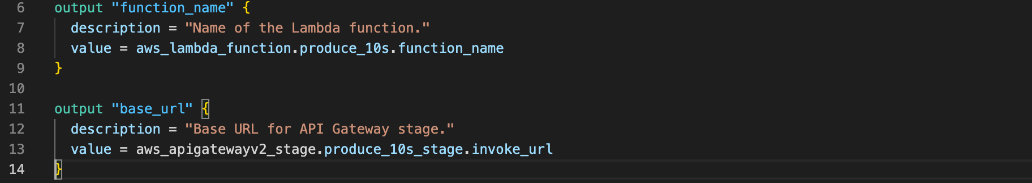
The Outputs File
The outputs file is where you configure any messages or data you want to show at the end of a terraform apply.

Slide 18
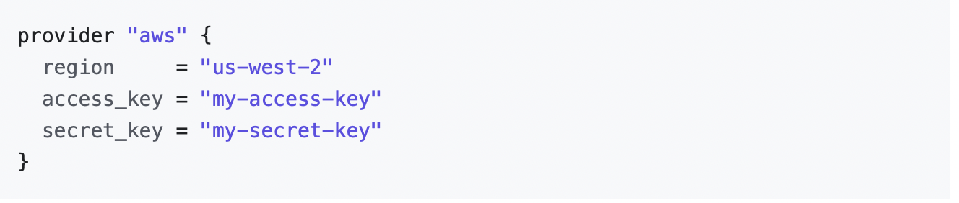
What we define in the main file?
Provider: Terraform relies on plugins called "providers" to interact with cloud providers.
Terraform configurations must declare which providers they require so that Terraform can install and use them.
Each provider adds a set of resource types and/or data sources that Terraform can manage.
How to declare provider in main file?

Slide 19
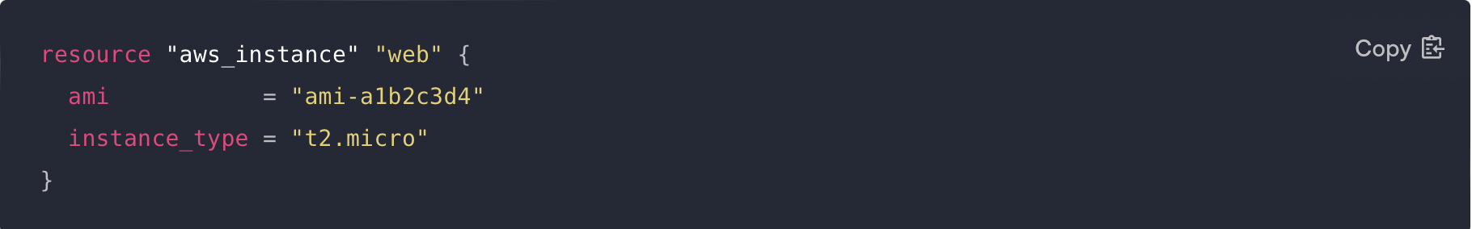
What we define in the main file?
Resources: Are the most important element in the Terraform language. Each resource block describes one or more infrastructure objects, such as virtual networks, compute instances, or higher-level components such as DNS records.
Resource syntax: resource “type of resource” “local name”:
Type of resource: S3, Lambda, API gateway …
Local name: The name is used to refer to this resource from elsewhere in the same Terraform module, but has no significance outside that module's scope.
Within the block body (between { and }) are the configuration arguments for the resource itself.

Slide 20
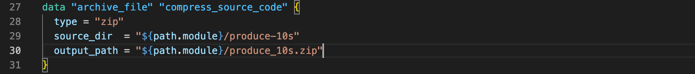
What we define in the main file?
Data sources: allow Terraform to use information defined outside of Terraform.
Syntax: data “type of data source” “local name”.

Slide 21
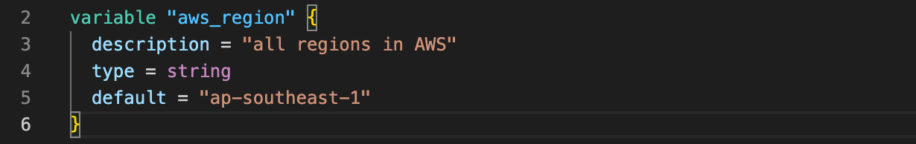
How we define variables in the variables file?
Input variables serve as parameters for a Terraform module, so users can customize behavior without editing the source.
Terraform CLI defines the following optional arguments for variable declarations.
default - A default value which then makes the variable optional.
type - This argument specifies what value types are accepted for the variable.
description - This specifies the input variable's documentation.

Slide 22
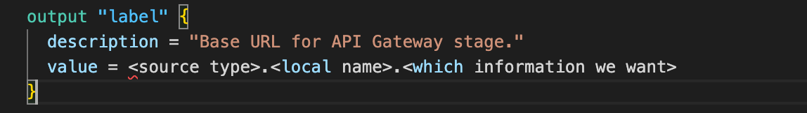
What we define in the output file?
Output values make information about your infrastructure available on the command line, and can expose information for other Terraform configurations to use. Output values are similar to return values in programming languages.
Syntax:

Slide 23
Demo

